Slide 1


The Future of Business Relations on the Blockchain
Member of Ethereum Enterprise Alliance

Slide 2
Executive Summary
The Future of Business Relations on the Blockchain
Opporty is a three-layered solution consisting of Proof-of-Expertise (PoE) protocol, a transaction-based scoring system for businesses, and a business marketplace on the blockchain, with a built-in Decentralized Escrow system
The Opporty project already has valuable traction, an eminent team, and an advisory board of industry experts
Opporty, with blockchain technology, scoring and alternative dispute resolution, allows for business operations without banks and courts in a dramatically faster and more secure way

Slide 3
Lack of trust and protection
The Future of Business Relations on the Blockchain
It is hard for new businesses to start working on established markets
Slow transaction speed: Bank transfers take from 1 to 5 working day
Lack of Trust in Business transaction :
- difficulty in validating the trustworthiness of counterparties
- fabricated reviews
- loss of actual and potential revenue
- lengthy and expensive dispute resolution
Lack of a common framework for alternative dispute resolution for small and mid size enterprises leads to the absence of alternatives to centralize court system

Slide 4
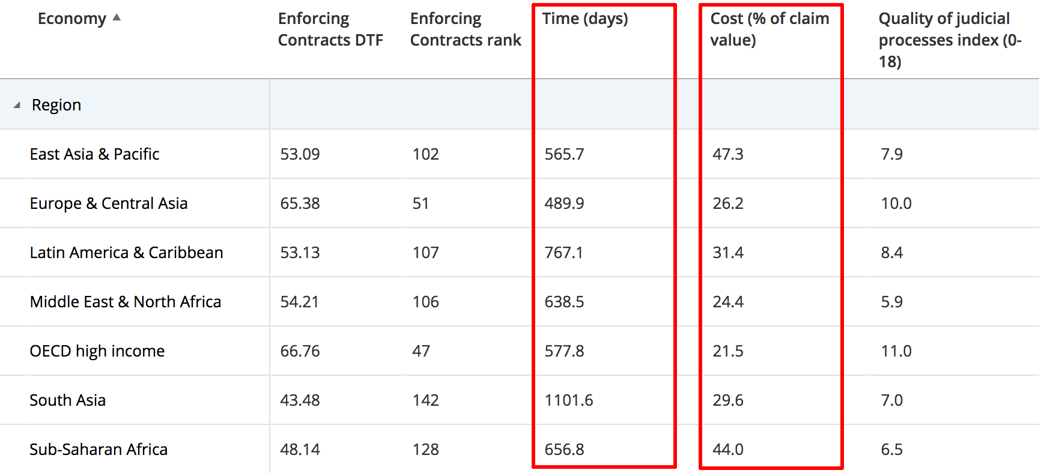
Industry Problems: Contract Enforcement

Slide 5
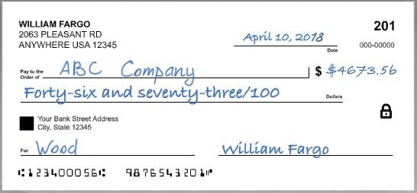


The Future of Business Relations on the Blockchain
Popular Blockchain protocols VS Business transactions
Popular Blockchains: Completely Transparent and Completely Anonymous
Business transactions: Always connected to identity and contain metadata about transactions (purpose, contract, invoice etc.)
Enterprise data storage applications: Always private with enabled levels of access
Supply Chain
Data Storage
ETC…

Slide 6
Opporty Solution
The Future of Business Relations on the Blockchain
Opporty is a three-layered business relationships ecosystem consisting of:
Proof-of-Expertise (PoE) protocol designed to quickly and privately process business transactions
A transaction-based scoring system for businesses.
A business marketplace built on the blockchain, with a built-in Decentralized Escrow system
With its unique combination of features, Opporty ensures transparency and security, standardizes procedures, and creates an environment of cooperation that instills trust between parties doing business.
1
2
3

Slide 7
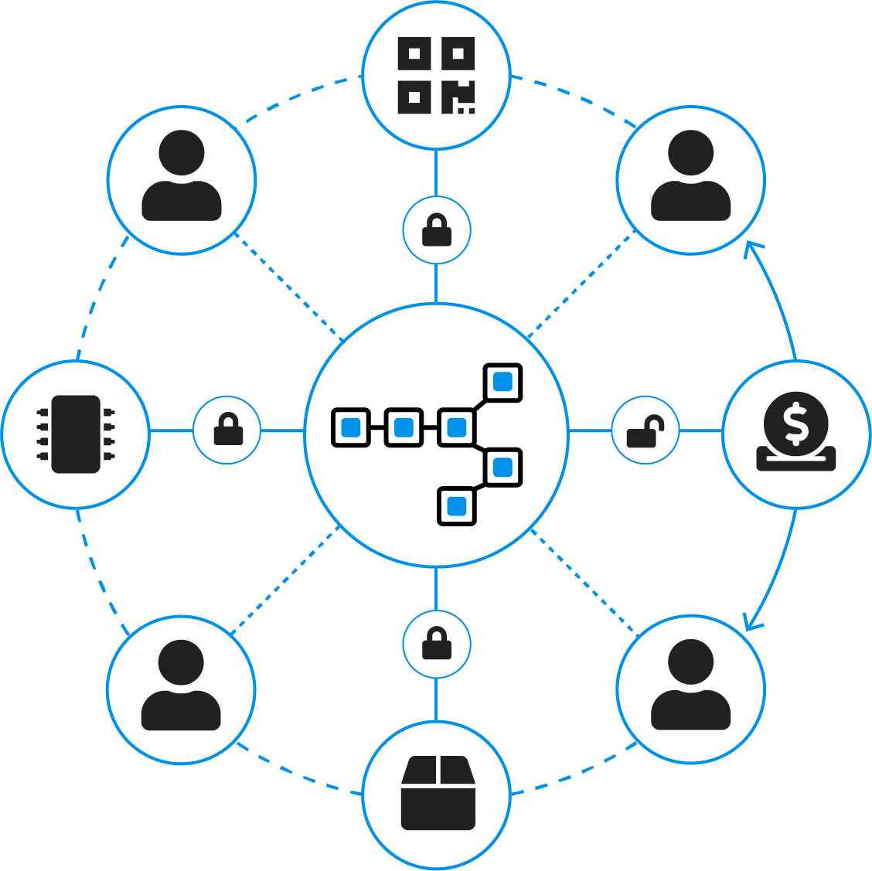



Protocol
The Future of Business Relations on the Blockchain
Proof-of-Expertise (PoE) protocol contains Business Digital ID, privately stored transactions metadata, and designed to process business transactions quickly and untraceable
Business digital identity
Private information storage
Untraceable transactions
Notes:
Busn digital id, priv store metadata, untr transactions

Slide 8








The Future of Business Relations on the Blockchain
Proof-of-Expertise Protocol — Components
Blockchain
Digital signatures
Nodes
Timestamps
Smart contracts
Levels of access
Oracles

Slide 9






The Future of Business Relations on the Blockchain
Proof-of-Expertise Protocol — Features
Privacy
Immutability
Scalability
Code transparency
Modality
Interoperability
Security

Slide 10






The Future of Business Relations on the Blockchain
Proof-of-Expertise Protocol — Use Cases
Production Tracking
Supply chain visibility
Food safety
Automatic settlement
Cross-border payments
and clearance
Asset transfer

Slide 11
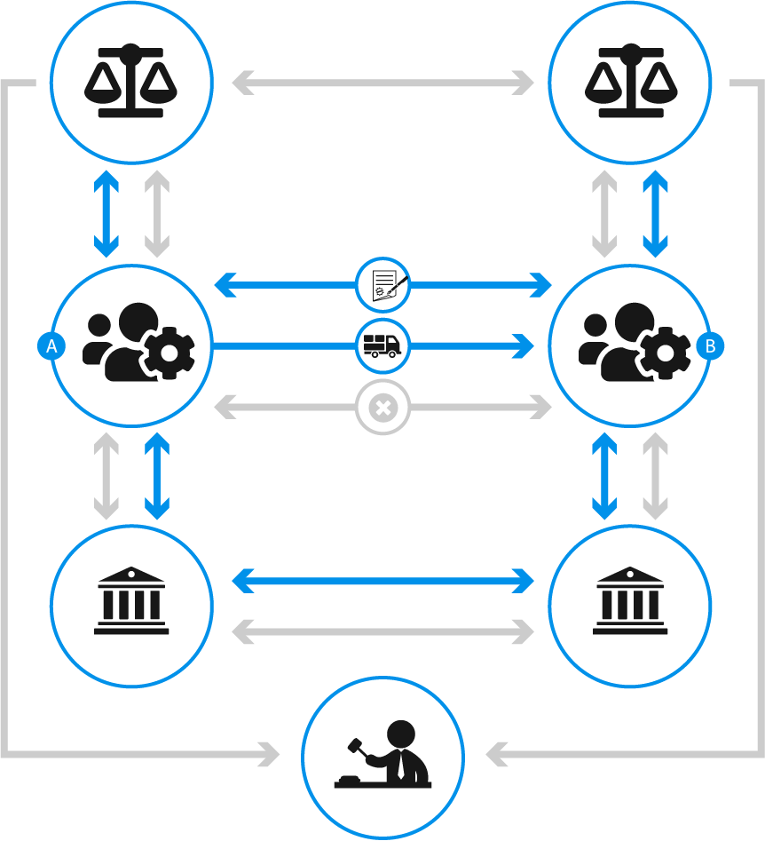
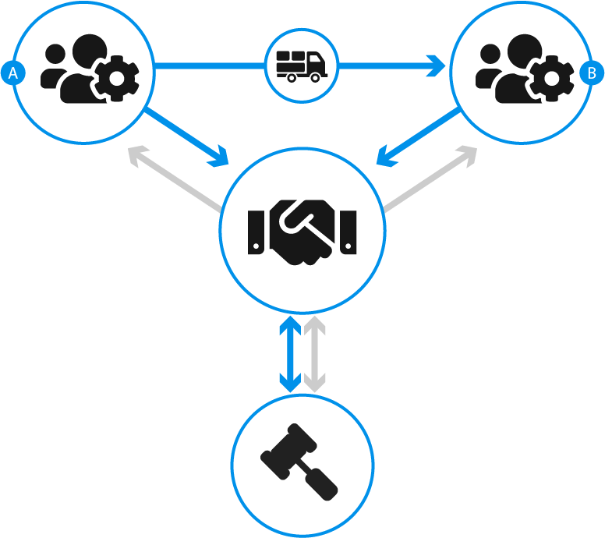
The Future of Business Relations on the Blockchain
Traditional deal
Blockchain-based deal
Transaction support fees and consulting services
Logistics, tracking, shipping documents
Protracted litigation and lawsuits
Frozen funds
Unconditional contract execution
Reduce paperwork in 15%
High-rate performance
Quick and unbiased settlement of disputes

Slide 12


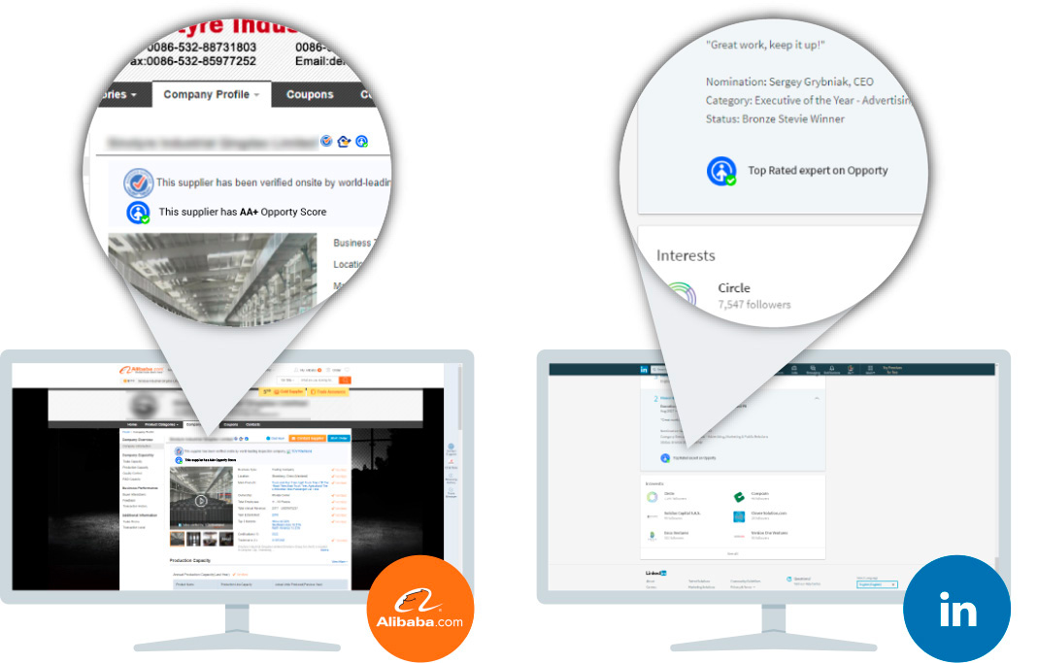
The Future of Business Relations on the Blockchain
Scoring System
Scoring allows users to earn a trust score as a result of successful transactions. Users can apply their tokens as a “stake” to build their reputation as a basis for trust.
Scoring facilitates decision-making and provides trustworthiness by allowing users to select a counterparty based on real unbiased business data, provided by an AI-enabled analytical engine, extracted from Big Data produced by business transactions

Slide 13
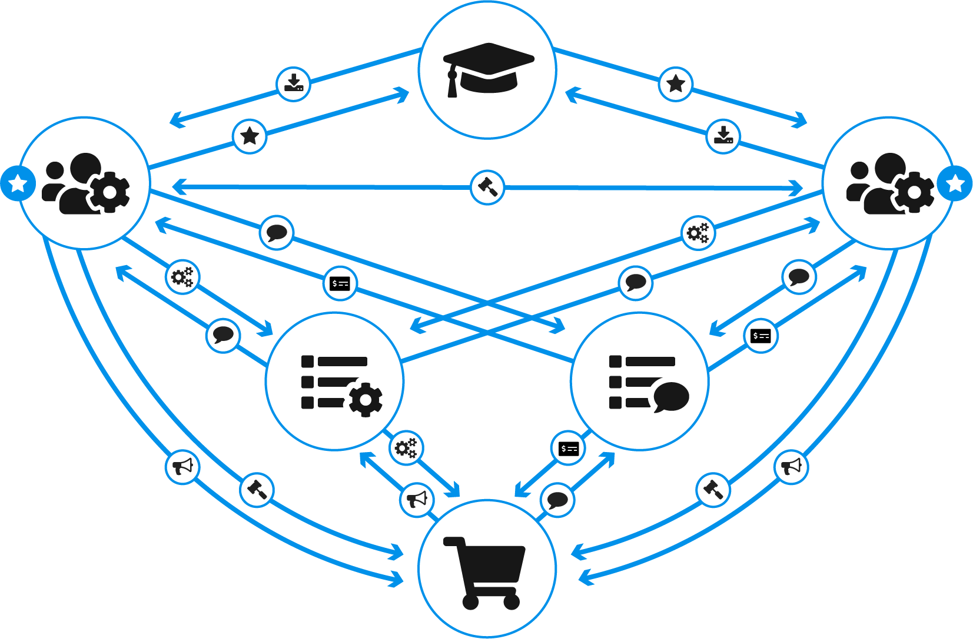
The Future of Business Relations on the Blockchain
Opporty Marketplace
Knowledge base
Company
Data input
Scoring
Company
Scoring
Data input
Scoring
Scoring
Requests
Escrow
Service
Service
Bids
Requests
Requests
List of services
List of requests
Requests
Bids
Escrow
Service
Bids
Escrow
Targeted offer
Offers
Requests
Targeted offer
Retail client

Slide 14







The Future of Business Relations on the Blockchain
Marketplace
Post requests for proposals and receive bids from proven business community members
Build your own business reputation by executing deals, providing services, and educating the community
Log in niche-oriented offers to target specific, niche-focused audiences
Execute safe transactions protected by decentralized escrow
Get your services listed at the B2B service marketplace
Get rewarded for contributing to community development, and for creating business opportunities for other community members
Enable and Utilize a Decentralized Escrow Mechanism, a framework of alternative dispute resolution for businesses on the blockchain

Slide 15

The Future of Business Relations on the Blockchain
Why use Opporty?
For Established Businesses: • Additional source of clients
• Ability to reinforce or recover reputation
• Ability to conduct business internationally
• Execute protected transactions with new providers
Fast, private, cost-efficient and secure transactions
Trusted and transparent b2b ecosystem
One of a kind business scoring and identity solution
Arbitration protected transactions
Smart contract protected solutions
Gamification based rewards system
For Enterprises and Government Procurement: • Extensive list of service providers
• Access to better service provision terms
• Services from trusted providers
• Protected transactions with new providers
• Settlement with subcontractors without bank involvement
For Startups:
• Validation of business plans
• Source of first clients
• Ability to establish trusted reputation
• Protected transactions with new providers
For Customers: • Better terms of service
• Protected transactions
• Great variety of services
Notes:
Startups – on third place

Slide 16





Token Utilization
The Future of Business Relations on the Blockchain
Utilize Proof-of-Expertise Protocol
Execute transactions between service providers and clients within the system
Pay for Opporty platform-based services, such as priority listings
Utilize smart contracts available on the Opporty platform, including decentralized escrow
Be incentivized with OPP tokens for contributions to the platform's development. Every user can participate in various activities on the platform (such as contributing to the Knowledge sharing platform) and receive rewards for those activities

Slide 17
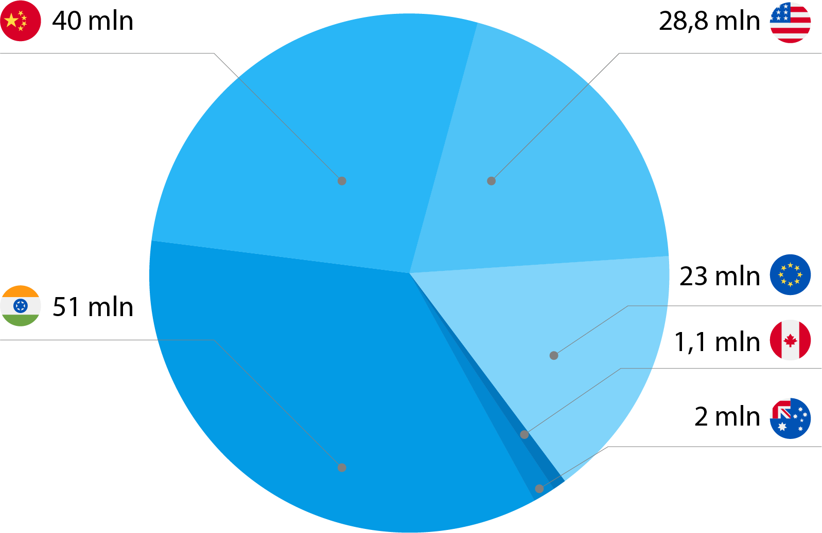
Market Opportunity
The Future of Business Relations on the Blockchain
Small and medium size businesses are the backbone of most economies. There are approximately 147 million small businesses in Opporty’s targeted markets

Slide 18
















Product Traction
The Future of Business Relations on the Blockchain
opporty.com
6,000+
Verified companies profiles
opporty.co.uk
1,000+
Verified companies profiles
opporty.ca
300+
Verified companies profiles
opporty.cn
In progress
30,000+ 700 -1800 daily Monthly unique visitors | 50,000,000+ Companies in our database | 15+ Contributing experts on the blog | 18+ K Services and Categories | 1,400+ Website users
First backend version of Plasma solution released
Smart widgets released
Opporty is starting operations in China
First working prototype
of Plasma Cash on Github
First private accounting office in New York
250+ media
outlets
Member of Enterprise Ethereum Alliance
Plasma Cash prototype transaction speed test successfully completed; 303K transactions processed per second

Slide 19
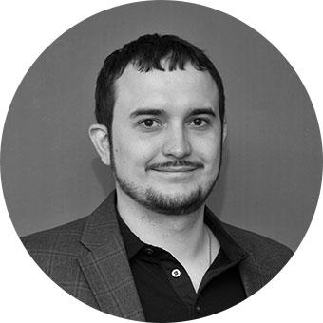



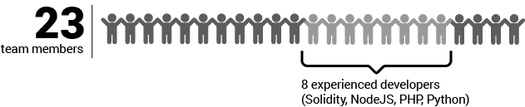
The Future of Business Relations on the Blockchain
Core Team: Founders & Execution Team
Sergey Grybniak
A serial entrepreneur, Sergey’s first venture is boutique IT consulting firm with over 50 full time employees focused on digital marketing and software development. He has experience working with big clients including Fortune 500 companies and companies with over 100 million monthly users. Sergey has over 100 mentions in the media and holds 2017 Executive of the Year award from Stevie Awards. He is also a regular contributing member of a number of respected international communities focused on application development and digital marketing.
Alex Bilichenko
Finance and machine learning expert, trader and investor, with over 10 years of experience at the world’s leading companies, including Microsoft, Bridgewater Associates, Goldman Sachs and Teza Technologies. During his tenure, Alex worked on building models for analyzing massive amounts of data to predict prices of financial assets across the globe. He embraced the blockchain and cryptocurrency revolution in 2013. Alex holds a PhD in Physics and BA/MS in Physics omputer Science.
The founders have sufficient expertise to cover all possible tasks that can arise on the project, from technical to organizational perspectives
Opporty is a US-based company with engineering offices in Ukraine

Slide 20


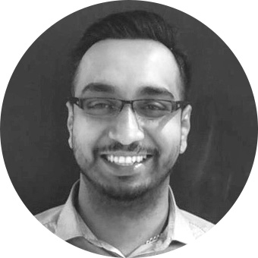
Team: Business Development and Partners in Asia
The Future of Business Relations on the Blockchain
Ms Jing ZENG
Business Development, Partner Ms Zeng has more than 20 years experiences in international capital marketing and corporate management, business and market development, and large scale project management. Previously Managing Director of BNP Paribas (China) Ltd., General Manager of BNP Paribas Securities Services China, Director of Asia Program of BNP Paribas Securities Services (Paris), Executive Director of Asia Development of German Stock Exchange.
Charles WONG Hon Chiu
Business Development, Partner, Advisor Project Engineer, Aerospace; sophisticated computer manufacturer, high quality IBM manufacturing system. Factory Manager, Development manager and Consultant of many industrial groups in Hong Kong and China.
RAAJIV SAMI Head of Strategy - APAC Raajiv is an entrepreneur with a background in wealth management and a comprehensive understanding of finance and technology. Some of the global brands Raajiv has represented include; St. James’s Place, MLC (part of the NAB group), AXA, AMP, Bankwest (part of the CBA Group), and ACAP (part of the Navitas group).

Slide 21
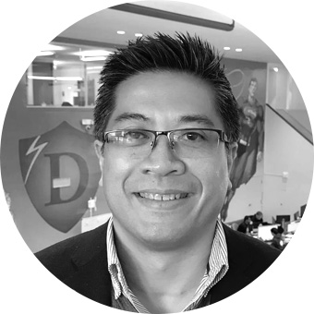


Team: Advisors
The Future of Business Relations on the Blockchain
HENRY INES
CIO, VC and Advisor Henry is a global executive with extensive venture capital, cross border advisory, corporate finance and entrepreneur experiences. As an investor, he focuses on FinTech / blockchain and frontier technology ventures based on his VC experiences to date as a partner at DraperDragon Fund, DFJ Dragon Fund and DragonVenture, Inc.
WULF KAAL Entrepreneur, Technologist, Professor Wulf Kaal is a leading expert on Blockchain Applications in a broad array of industries, initial coin offerings, and smart contracting, as well as private investment fund regulation and compliance.
RICKY NG Founder of I-house.com & I-house Token Chairman and founder of I-house.com & I-house Token (IHT), the first blockchain real estate cloud platform worldwide. Co-founder, Director of McAfeeCC, one of the largest crypto fund founded in 2017. Co-Founder of Iclick Interactive, one of the largest digital advertising platform in greater China area.

Slide 22
The Future of Business Relations on the Blockchain
Thank you for your interest!
Sergey Grybniak, Founder
info@opporty.com
+1 888 293 0007

